Slide 1
Hiring process analytics for a multinational company..
G. Kiruthik Chakra | BADM-WD-T-B9

Slide 2
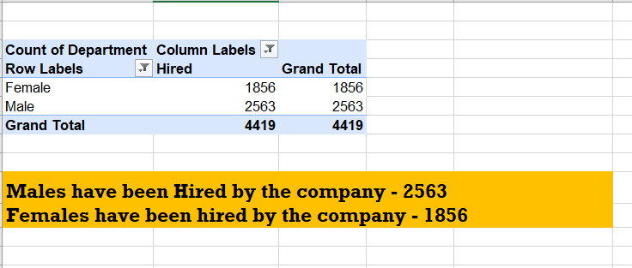
Task-a hiring analysis
Determine the gender distribution of hires. How many males and females have been hired by the company?
Result:

Slide 3
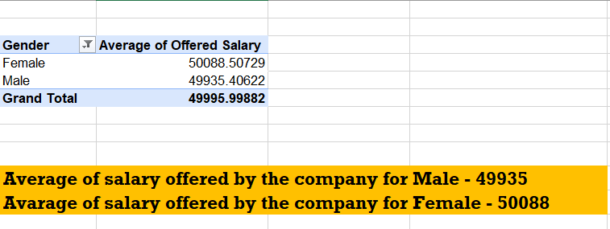
Task-b salary analysis
What is the average salary offered by this company? Use Excel functions to calculate this.
Result:

Slide 4
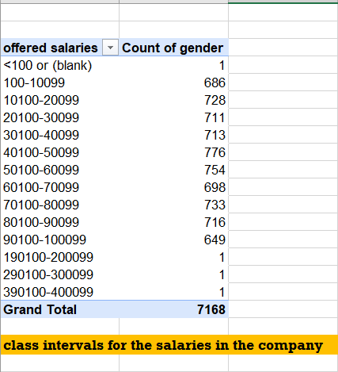
Task-c salary distribution
Create class intervals for the salaries in the company. This will help you understand the salary distribution.
Result:

Slide 5
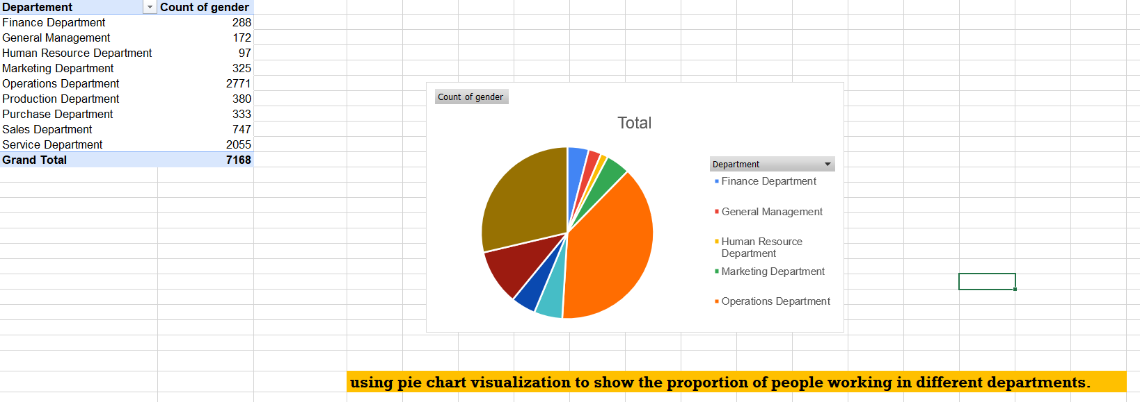
Task-d departmental analysis
Use a pie chart, bar graph, or any other suitable visualization to show the proportion of people working in different departments.
Result:

Slide 6
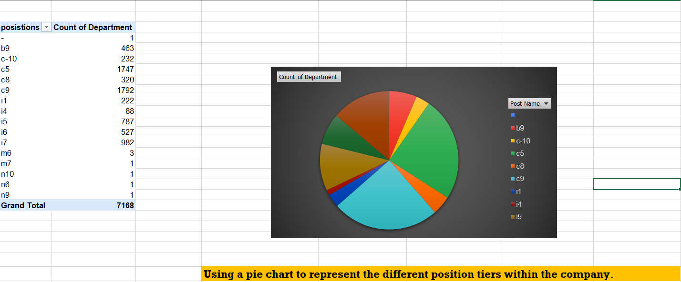
Task-e position tier analysis
Use a chart or graph to represent the different position tiers within the company. This will help you understand the distribution of positions across different tiers.
Result:

Slide 7
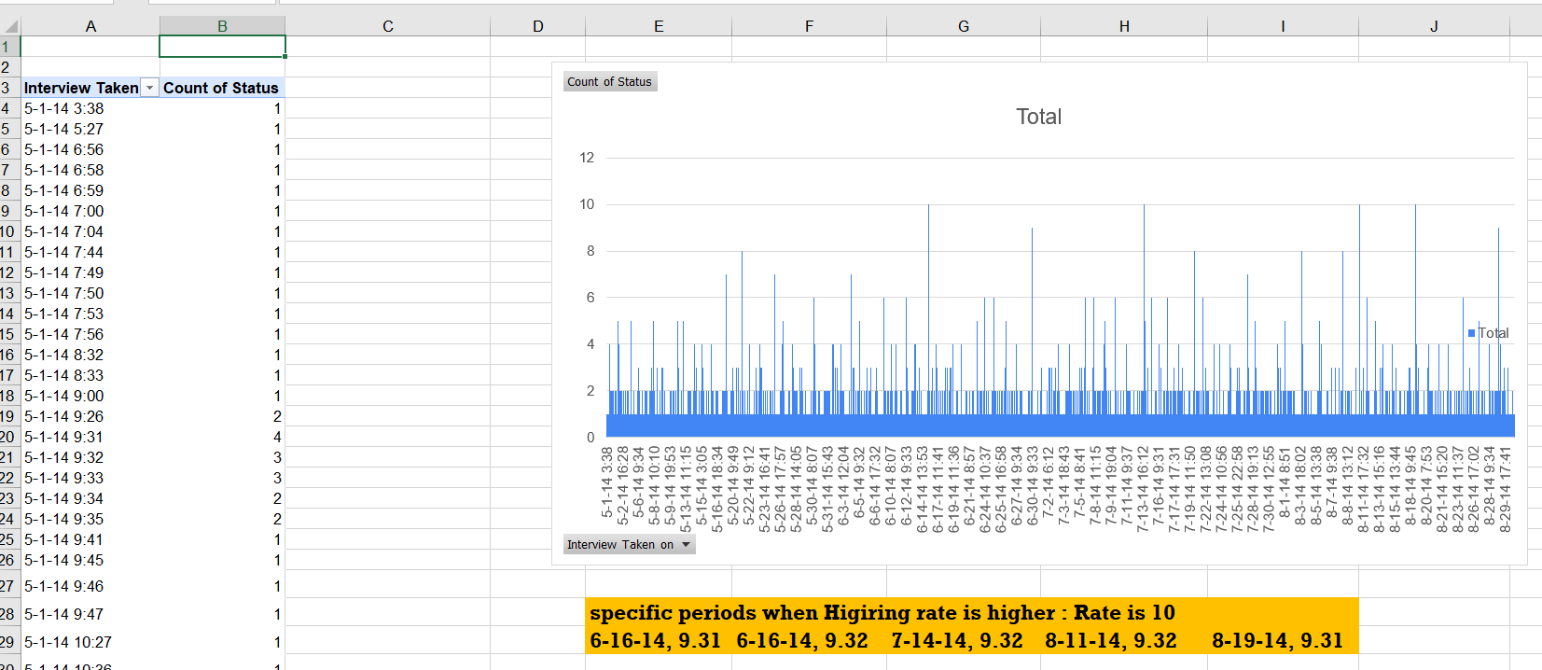
Task-f interview time analysis
Analyze the data to identify any trends related to the date or time of the interviews. Are there specific periods when hiring rates are higher or lower? Use Excel functions to identify patterns and visualize the results using charts.
Result:

Slide 8
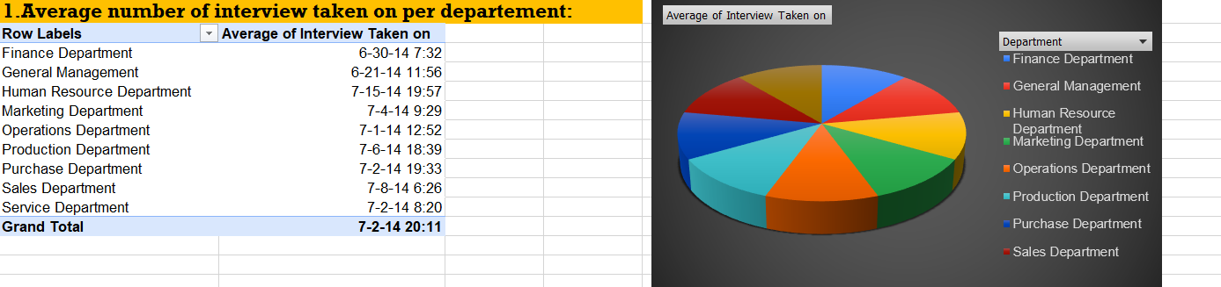
Task-g interview metric analysis
Calculate metrics such as the average number of interviews conducted per position or department, the average time-to-hire, and other related measures. Use these metrics to evaluate the efficiency and effectiveness of the hiring process in different departments.
Result 1 :

Slide 9
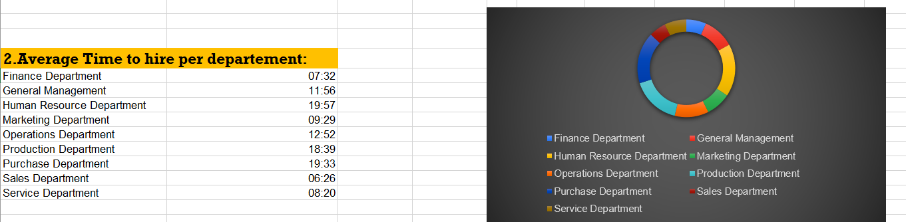
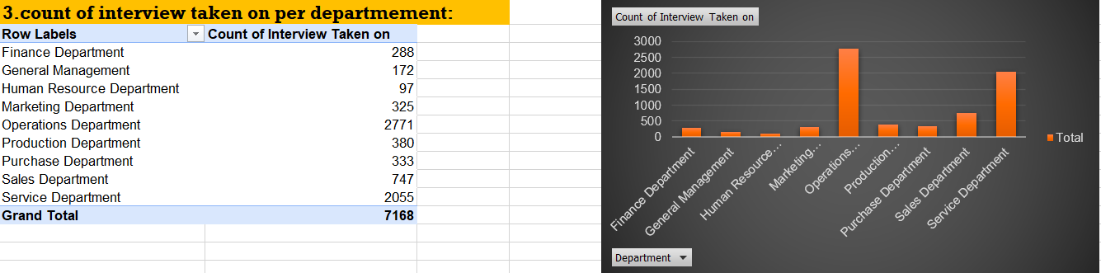
Result 2:
Result 3 :

Slide 10
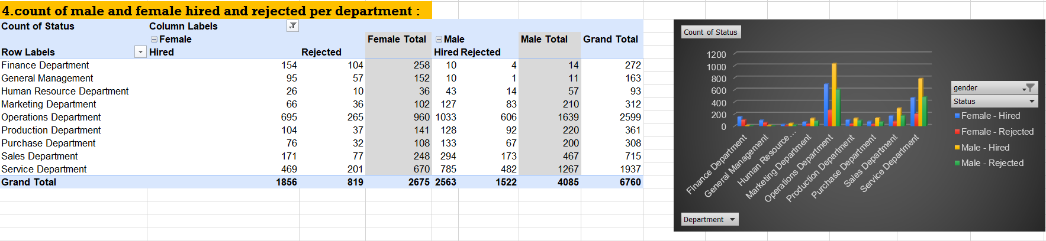
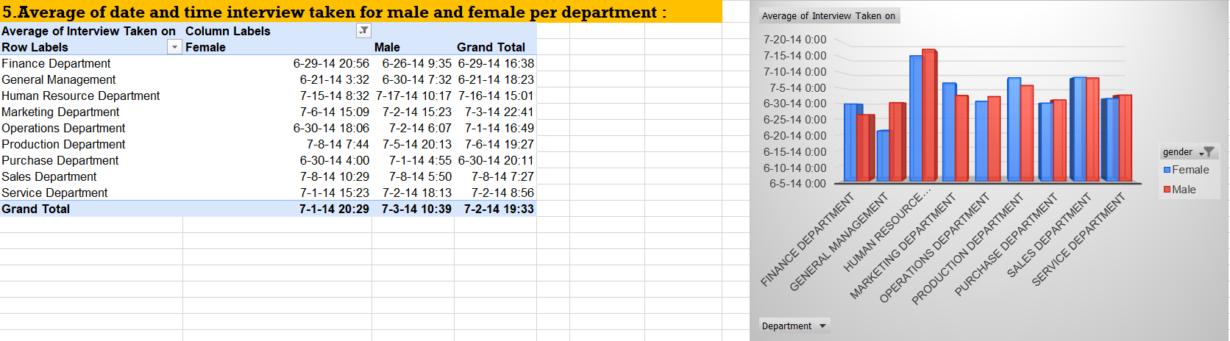
Result 4 :
Result 5 :

Slide 11
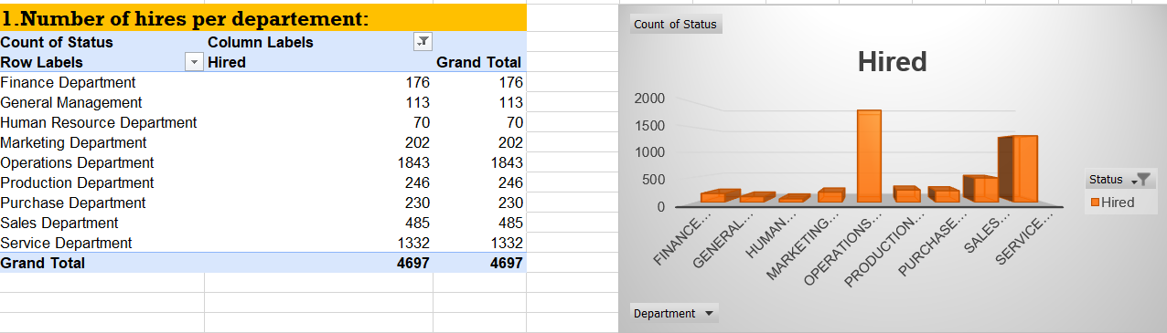
Task-h departmental hiring trends comparison
Compare department-wise hiring trends by analyzing the number of hires, rejections, and time-to-hire across different departments. Identify which departments hire the most and explore potential reasons behind these trends. Visualize your findings using appropriate charts or graphs.
Result 1 :

Slide 12
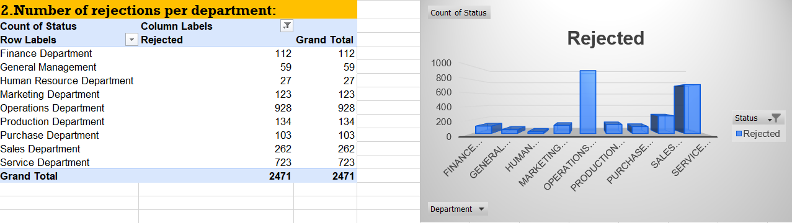
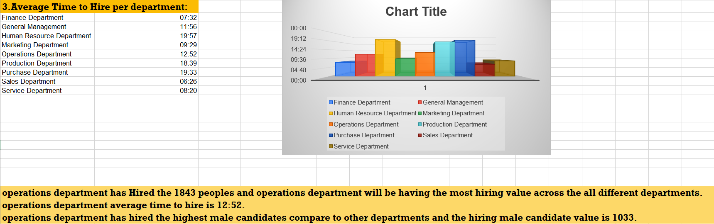
Result 2 :
Result 3 :

Slide 13
Here is the link for this project findings and calculations excel sheet:
https://docs.google.com/spreadsheets/d/1V6Kah9Xqo3fJgpX98zyrkc5UdXS3cFfM/edit?usp=drive_link&ouid=113433772495243206201&rtpof=true&sd=true

Slide 14
Thank you…..

